Slide 1
Testing scientific code, Part II Because you’re worth it
Lisa Schwetlick and Pietro Berkes

Slide 2
Testing patterns

Slide 3
What a good test looks like
What does a good test look like? What should I test?
Good:
Short and quick to execute
Easy to read
Exercise one thing
Bad:
Relies on data files
Messes with “real-life” files, servers, databases

Slide 4
Basic structure of test
A good test is divided in three parts:
Given: Put your system in the right state for testing
Create data, initialize parameters, define constants…
When: Execute the feature that you are testing
Typically one or two lines of code
Then: Compare outcomes with the expected ones
Define the expected result of the test
Set of assertions that check that the new state of your system matches your expectations

Slide 5
Test simple but general cases
Start with simple, general case
Take a realistic scenario for your code, try to reduce it to a simple example
Tests for ‘lower’ method of strings
def test_lower(): # Given string = 'HeLlO wOrld' expected = 'hello world' # When output = string.lower() # Then assert output == expected

Slide 6
Test special cases and boundary conditions
Code often breaks in corner cases: empty lists, None, NaN, 0.0, lists with repeated elements, non-existing file, …
This often involves making design decision: respond to corner case with special behavior, or raise meaningful exception?
def test_lower_empty_string(): # Given string = '' expected = '' # When output = string.lower() # Then assert output == expected
Other good corner cases for string.lower():
‘do-nothing case’: string = 'hi'
symbols: string = '123 (!'
Notes:
First of all, you should start with testing your code with
explain typical test structure
show general case: two words, upper case chars randomly dispersed
special cases
SHOW THIS (cut & paste code)

Slide 7
Common testing pattern
Often these cases are collected in a single test:
def test_lower(): # Given # Each test case is a tuple of (input, expected_result) test_cases = [('HeLlO wOrld', 'hello world'), ('hi', 'hi'), ('123 ([?', '123 ([?'), ('', '')] for string, expected in test_cases: # When output = string.lower() # Then assert output == expected

Slide 8
Parametrize
Sometimes you want to run the same test multiple times with different values
Option 1: for loop in your test
Option 2: parametrize
@pytest.mark.parametrize("a", [1,2,3,4])
def test_addition_increases(a):
assert 5+a>a

Slide 9
Parametrize
… is also useful when you want to test different cases and their outcomes!
@pytest.mark.parametrize("string, expected",
[('HeLlO wOrld', 'hello world’),
('hi', 'hi’),
('','')])
def test_lower(string, expected):
# When output = string.lower()
# Then assert output == expected

Slide 10
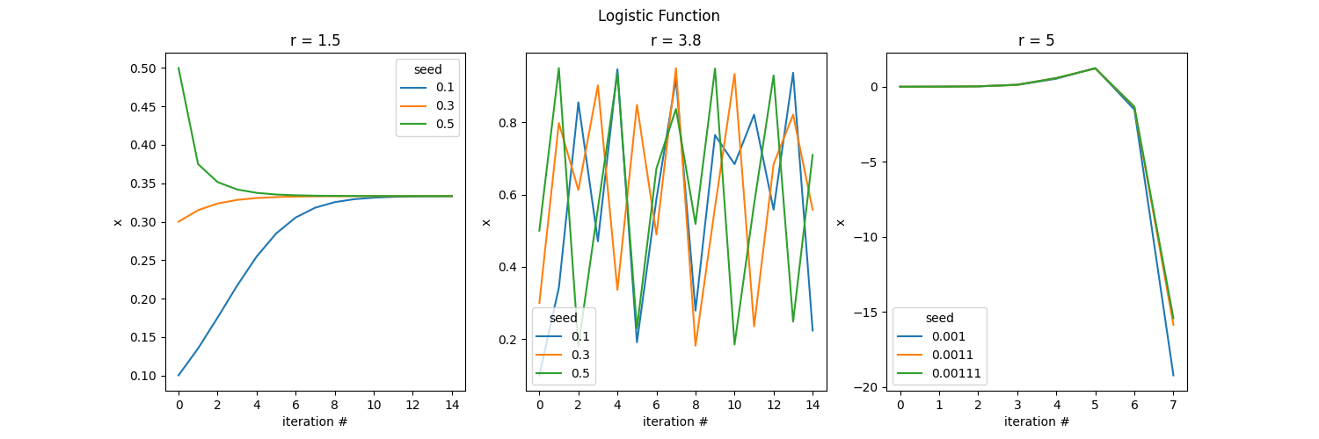

Excursion: Logistic Map
Sometimes used as a simple model for population growth

Slide 11
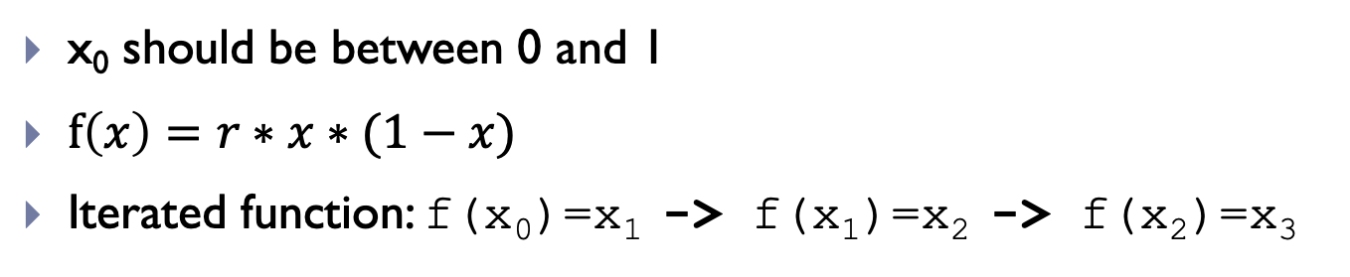
Excursion: Logistic Map
x₀ should be between 0 and 1
$f\left(x\right)=r∗x∗(1−x)$
Iterated function: f(x₀)=x₁ -> f(x₁)=x₂ -> f(x₂)=x₃
Notes:
where x_{n} is a number between zero and one, that represents the ratio of existing population to the maximum possible population

Slide 12
Excursion: Logistic Map
Looking at these plots, what could you test?

Slide 13
Hands-on!
First fork the repo https://github.com/ASPP/2022-bilbao-testing-project on GitHub and clone your own copy!
a) Implement the logistic map f(𝑥)=𝑟∗𝑥∗(1−𝑥) . Use `@parametrize` to test the function for the following cases:
x=0.1, r=2.2 => f(x, r)=0.198
x=0.2, r=3.4 => f(x, r)=0.544
x=0.75, r=1.7 => f(x, r)=0.31875
b) Implement the function iterate_f that runs f for it iterations, each time passing the result back into f. Use @parametrize to test the function for the following cases:
x=0.1, r=2.2, it=1 => iterate_f(it, x, r)=[0.198]
x=0.2, r=3.4, it=4 => f(x, r)=[0.544, 0.843418, 0.449019, 0.841163]
x=0.75, r=1.7, it=2 => f(x, r)=[0.31875, 0.369152]]
c) Use the plot_trajectory function from the plot_logfun module to look at the trajectories generated by your code. Try with values r<3, r>4, and 3<r<4 to get an intuition for how the function behaves differently with different parameters.

Slide 14
Marking tests (xfail)
Aside from parametrize, there are some other built in markers
Sometimes you have a test that fails, but for good reason or you just want to deal with it later…
Expected failure (xfail)
Outputs an “x” (or “X”) in place of the “.”
@pytest.mark.xfail
def test_something():
...

Slide 15
Marking tests (skip)
It is also possible to skip tests
Useful when the feature doesn’t exist yet or the test is very slow
@pytest.mark.skip(reason=“functionality not yet implemented”)
def test_something():
...

Slide 16
Marking tests with custom markers
If you have lots of tests, you can categorize them with your own markers
although for custom mark names you need to register the marks “pytest.ini”
https://docs.pytest.org/en/7.1.x/example/markers.html#registering-markers
Example:
Smoke tests check for really basic failure: run these frequently
Other tests may be many or too slow to run every time and test for more edge cases
@pytest.mark.smoke
def test_something_basic():
...
> pytest –m smoke
> pytest –m ”smoke and not slow”

Slide 17
Testing scientific code

Slide 18
Strategies for testing learning algorithms
Learning algorithms can get stuck in local maxima, the solution for general cases might not be known (e.g., unsupervised learning)
Turn your validation cases into tests
Stability tests:
Start from final solution; verify that the algorithm stays there
Start from solution and add a small amount of noise to the parameters; verify that the algorithm converges back to the solution
Generate data from the model with known parameters
E.g., linear regression: generate data as y = a * x + b + noise for random a, b, and x, then test that the algorithm is able to recover a and b
Notes:
…
There is no general rule for testing these algorithm, for each specific algorithm there are usually validation cases (e.g, a classifier might be validated using two classes of very different objects)

Slide 19
Other common cases
Test general routines with specific ones
Example: test polynomial_expansion(data, degree) with quadratic_expansion(data)
Test optimized routines with brute-force approaches
Example: test function computing analytical derivative with numerical derivative

Slide 20

Randomness in Testing
Using randomness in testing can be useful
For confirming generalizability and stability
For finding corner cases or numerical problems
Using Random/Sampled input data to test whether the result is as expected
def test_something():
for _ in range(10): r = np.random.rand()
assert my_random_function(r)
Notes:
numpy.random.RandomState!
random_state = np.random.RandomState(SEED)
random_state.rand()
otherwise using the global seed, if any external library uses np.random it can screw up the determinism

Slide 21
Random Seeds and Reproducibility
When running tests that involve radomness and some test doesn’t pass it is vital to be able to reproduce that test exactly!
Computers produce pseudo-random numbers: setting a seed resets the basis for the random number generator
This is essential for reproducibility
At a minimum, you should manually set the seed for your random test
SEED = 42
random_state = np.random.RandomState(SEED)
random_state.rand()
Notes:
numpy.random.RandomState!
random_state = np.random.RandomState(SEED)
random_state.rand()
otherwise using the global seed, if any external library uses np.random it can screw up the determinism

Slide 22
A Pytest Solution
This is not so prominent in the docs, because non-scientific coding uses random testing more rarely
In scientific coding, when you deal with randomness it is very relevant
What do we want?
For each (random) test there should be a seed
For each run of the test, the seed should be different
That seed should be printed with the test result
It needs to be possible to explicitely run the test again with that seed!

Slide 23
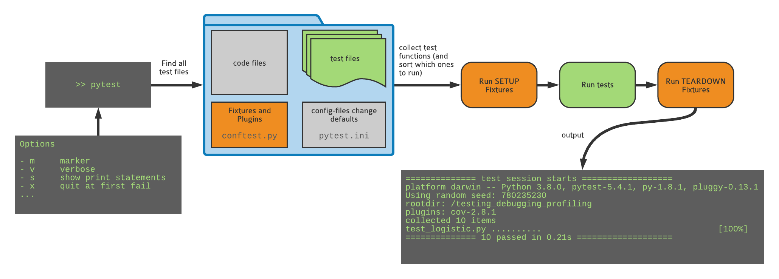
Pytest

Slide 24
Fixtures (minimal solution)
Fixtures are functions that are run before the tests are executed
They are defined in a file called conftest.py, in the same directory as the tests
import numpy as np
import pytest
# set the random seed for once here
SEED = np.random.randint(0, 2**31)
@pytest.fixture
def random_state():
print(f'Using seed {SEED}')
random_state = np.random.RandomState(SEED)
return random_state
def test_something(random_state): random_state.rand()

Slide 25
Fixtures (real solution)
conftest.py is a magical file! (don’t import it!)
Some test suites require specific or custom fixtures and plugins. They can be defined in conftest.py
See the file in the repo you forked. The functions defined there select a seed for each test and allow you to pass a seed on the commandline using --seed 123

Slide 26

Hands On!
a) Write a numerical fuzzing test that checks that, for r=1.5, all starting points converge to the attractor f(x, r) = 1/3.
b) Add a conftest.py file to set a random seed before each run and make the failure reproducible
c) Check that the console output of pytest now includes the seed!

Slide 27
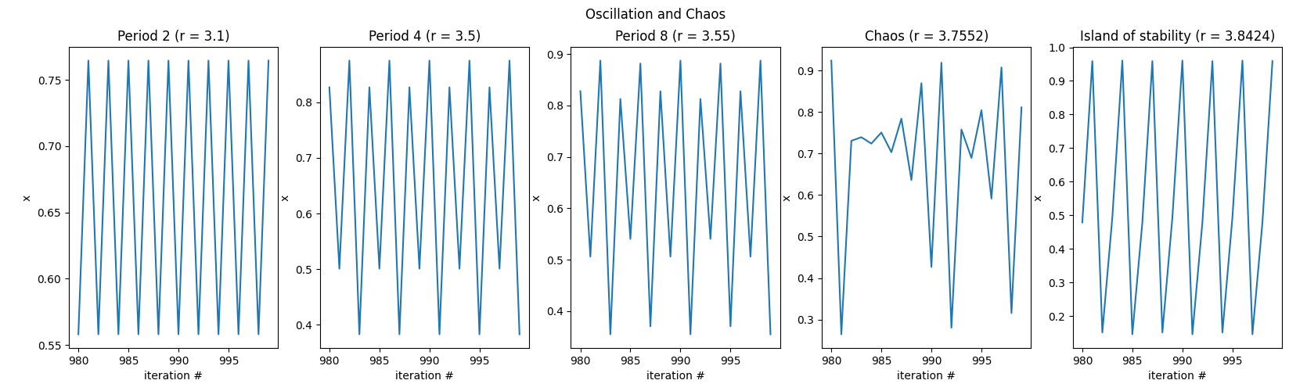
Excursion: Logistic Equation
Between r=3 and r=4 the logistic map has a range of behaviors
Periodic vs. chaotic

Slide 28
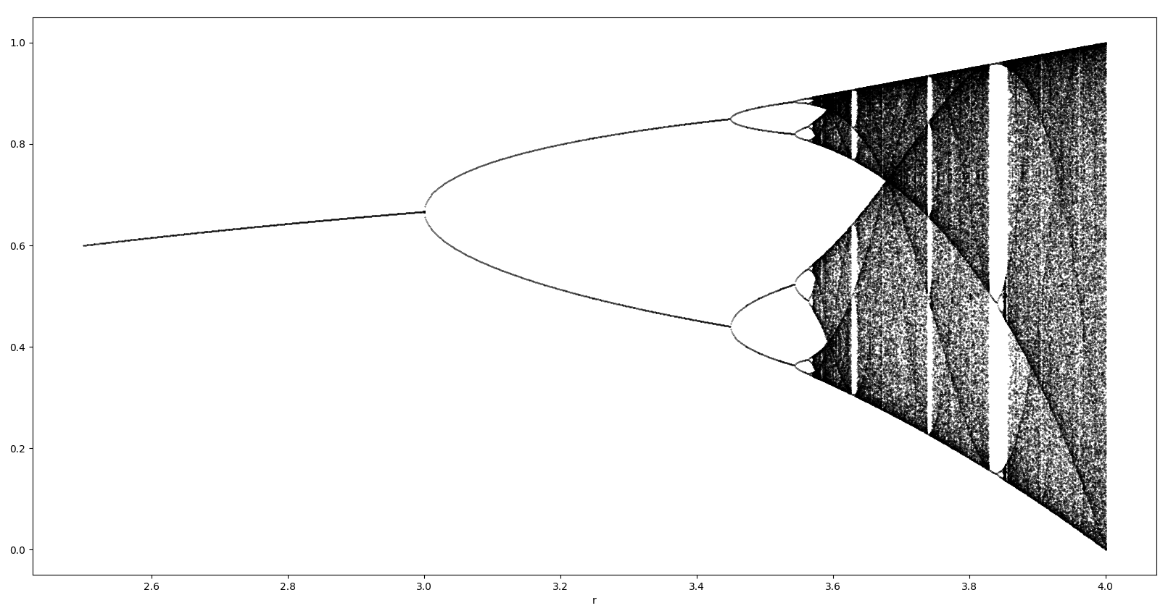
Excursion: Logistic Equation

Slide 29
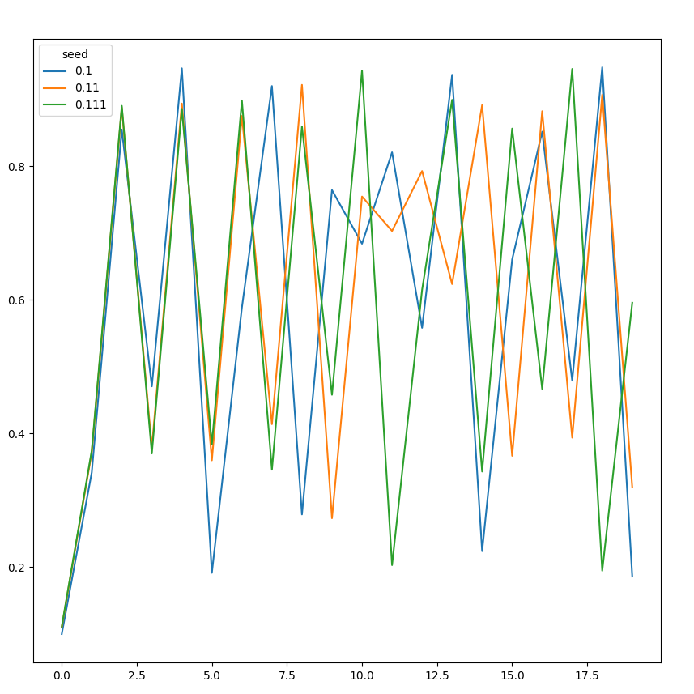

Excursion: Logistic Equation
Sensitive Dependence on Initial Conditions (SDIC)
Even seeds that are very close, quickly find completely different itineraries
Butterfly effect

Slide 30
Hands on!
Some r values for 3 < r < 4 have some interesting properties: a chaotic trajectory neither diverges nor converges.
a) Use the plot_bifurcation function from the plot_logfun module using your implementation of f and iterate_f to look at the bifurcation diagram. The script generates an output image, bifurcation_diagram.png
b) Write a test that checks for chaotic behavior when r=3.8. Run the logistic map for 100000 iterations and verify the conditions for chaotic behavior:
1) The function is deterministic: this does not need to be tested in this case
2) Orbits must be bounded: check that all values are between 0 and 1
3) Orbits must be aperiodic: check that the last 1000 values are all different
4) Sensitive dependence on initial conditions: this is the bonus exercise (in readme)
The test should check conditions 2) and 3)!

Slide 31
Testing is good for your self-esteem
Immediately: Always be confident that your results are correct, whether your approach works of not
In the future: save your future self some trouble!
If you are left thinking “it’s cool but I cannot test my code because XYZ”, talk to me during the week and I’ll show you how to do it ;-)
Notes:
in Python2 environment:
py.test -v mdp/test/test_node_covariance.py
and
py.test mdp/test/
(it takes one minute)

Slide 32
Final thoughts
Good programming practices, with testing in the front line, make us confident about our results, and efficient at navigating our research projects
The agile programming cycle gives you intermediate goals to build upon

Slide 33
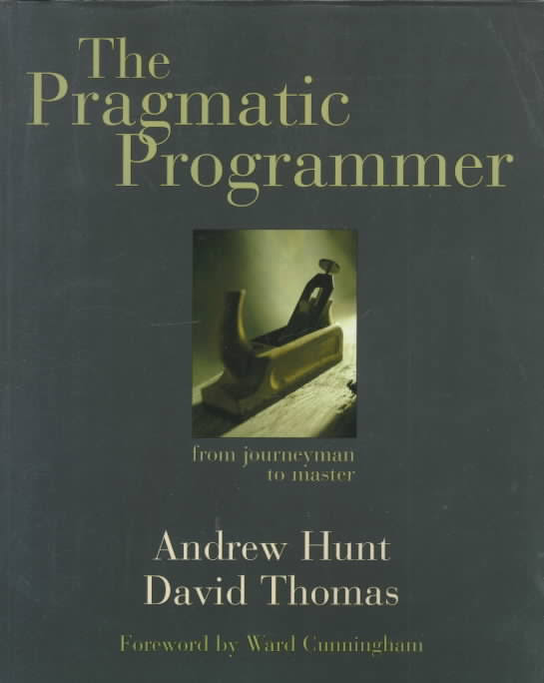

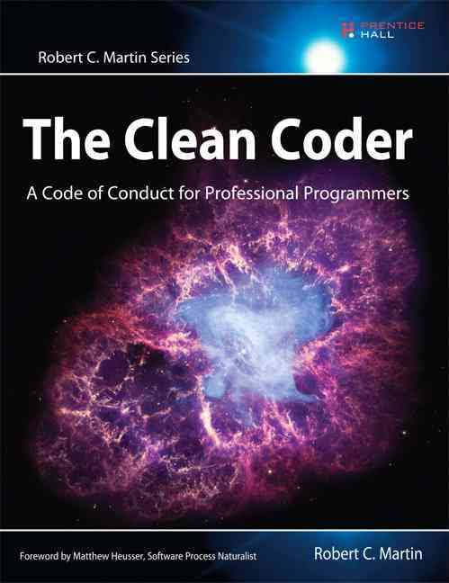
Recommended reading

Slide 34
Thank you!

